Slide 1


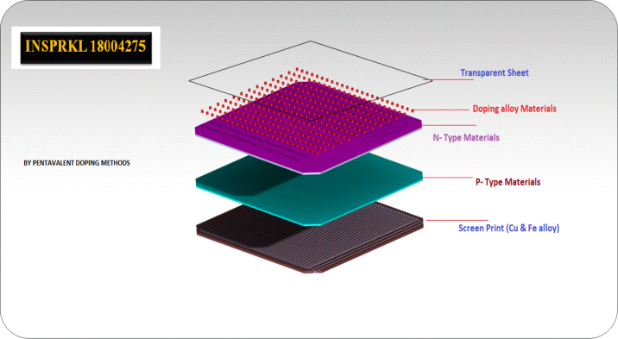
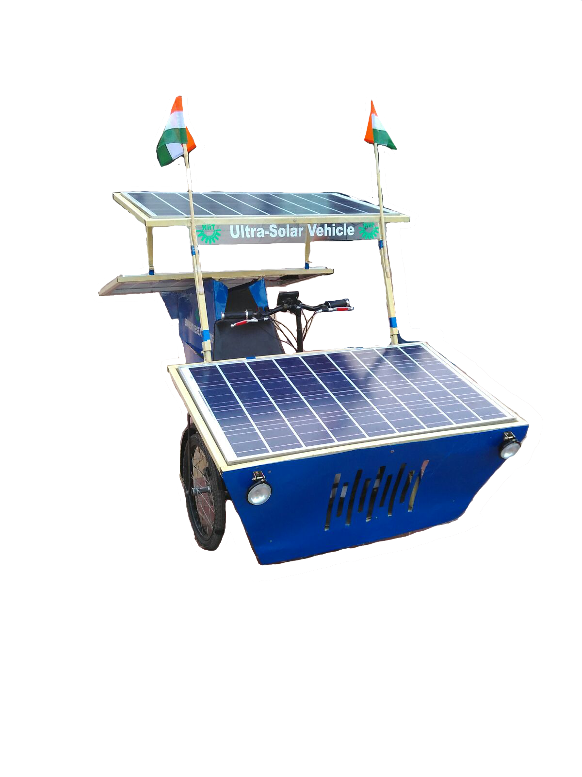
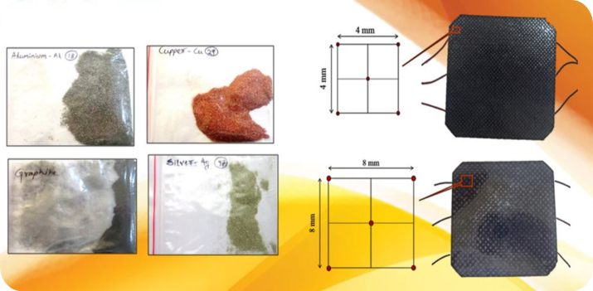
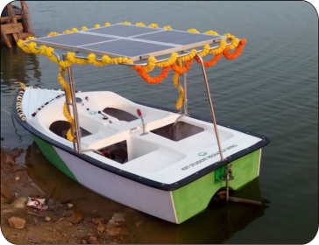
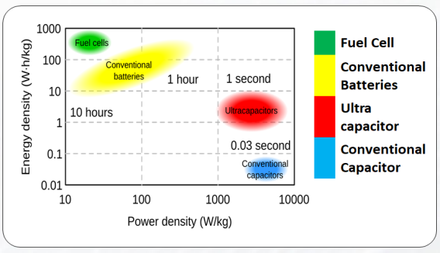
KIIT Student Research Centre
Boosting the efficiency of Solar PV power management system for charging of EV & HEV by using U-Cap Technology
Present situations and development of technologies are evidence that in coming years there will be huge use of EV(Electric Vehicle) & HEV(Hybrid-Electric Vehicle). So the problems listed below need to overcome so as to have a proper utilization of electrical and solar vehicle technology:
Requirement of charging station
Utilization of solar power
Sluggish charging
Maintaining eco-friendly environment
Present scope of use in a business mode.
Best mode of transportation inside a different campus.
No regular investments like fuel/electricity.
Zero emission.
100% runs on green energy.
High efficiency.
Silent Running.
Test Vehicle Specification :
Motor Power = 750 W
Voltage = 36 VDC
Electronic Speed Control
Speed = 38 to 45 Km/hr.
Solar panel = 300 W
Voltage = 36 VDC
Tadpole Vehicle Design
Rear Wheel Drive
Single Seated Driving System
This vehicle able to run on direct solar without battery with our developed PMS and Buck-Boost Circuit
Test boat Specification :
Motor power: 400 W
Voltage : 48 volt DC
Solar panel : 160 watt (40x4)
Solar panel voltage: 48Volt DC
Dimensions (L X B ): 9 ft X 4ft
Draft: 11 inch
Capacity:4 person
Depth:1 feet 8 inch
Approx Weight:75
Speed:16 Knots
Developed solar panel specification:
Peak Power Pmax (Wp) : 92
Maximum Voltage Vmpp (V) : 13.8
Maximum Current Impp (A) :5.43
Open Circuit Voltage Voc (V) :17.2
Short Circuit Current Isc (A) :5.84
Module Efficiency (%) :21.3
Dopping materials : Copper alloy (R133)
This solar boat able to run on direct solar without battery with our developed PMS and Buck-Boost Circuit
Future modifications and its modified uses.
This technology can also be implemented on:
Battery life extension.
Audio systems.
Solar powered electric gates.
Remote equipment monitoring.
Remote weather station.
Vehicle battery replacement with smaller size
Emergency backup power.
Bus voltage stabilization.
Space Application
Conclusion/Summary:
Hence, by replacing the batteries with Electric Double Layer Capacitor and with our self made solar panels we can charge an EV and HEV within seconds which solve the problem of sluggish charging and availability of solar charging stations. Our innovation is a completely based on Green Technology.
“ENERGY 2023: A VISION OF THE FUTURE”
School of Mechanical Engineering
KALINGA INSTITUTE OF INDUSTRIAL TECHNOLOGY
- Deemed to be University U/S 3 of UGC Act, 1956 -

